Slide 1

Public Speaking Toolbox
ds

Slide 2

“High school graduates will depend heavily on their ability to vocalize their thoughts, communicate orally, listen attentively to others, and incorporate multimedia examples in presentations.”

Slide 3
Speaking is a balance between…
Content
Voice Body Language

Slide 4
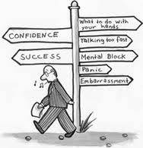

Slide 5
Delivery
Voice
Body Language
Volume
Pitch
Quality
Articulation
Rate
Variety
Position
Posture
Gestures
Face
Eye Contact

Slide 6
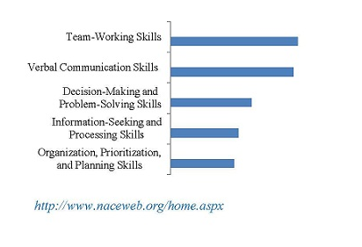
According to the National Association of Colleges and Employers

Slide 7
VOICE

Slide 8
Volume
The level at which your voice is used and can be heard
Tips
  Project your voice to connect with your audience
  Use appropriate strength and intensity
  Vary to add emphasis and dramatic impact

Slide 9
Pitch
The highness or lowness in the sound of your voice
Common to begin with a high pitch, or inflect pitch at the end of sentences
Varies by gender
Tip:
  Vary speech to express emotion and conviction

Slide 10
Voice Quality
Your speaking sound
Expresses emotion
Sets tone
Establishes relationship
Tips:
  Relax!

Slide 11
Articulation: how distinctly you formulate your words when you speak.
Pronunciation
Enunciation
Formation and utterance of words; the product of correct sounds in the sequence of a word.
Examples: just—jist, going to—gunna, supposedly-- su-pos-ab-lee
The fullness and clarity of speech sounds.
Tip:
  Shape tongue, teeth, palate, lips, and nose.

Slide 12
Articulation Drill
Repeat slowly at first, then progressively faster.
Red leather, yellow leather

Slide 13
Articulation Drill
Say the line slowly at first, then repeat faster and faster.
The tip of the tongue, the teeth and the lips

Slide 14
Now try it with a pen in your mouth
The tip of the tongue, the teeth and the lips

Slide 15
Rate
How quickly or slowly you speak
Slow speakers encourage listeners to daydream; people think faster than the flow of speech
Fast speakers frustrate listeners when information is spewed out at a rapid rate.
Tips:
  120-160 words/minute
  Vary your rate to keep attention

Slide 16
Vocal Variety
The way you use your voice to create interest, excitement, and emotional involvement.
Inflection: a raised pitch to place emphasis to a word.

Slide 17
Vocal Variety Drill
A single change in inflection can change the meaning of a sentence:
I was born in Illinois (You were born somewhere else)
I was born in Illinois (How dare you imply that I wasn’t)
I was born in Illinois (I’m a native- not a newcomer)
I was born in Illinois (Not outside of Illinois)
I was born in Illinois (Not in Minnesota)

Slide 18
Meet Phil Davidson
http://www.youtube.com/watch?v=LMy_5ypyaRs&safe=active

Slide 19

Speech 1: Richard Turere: My invention that made peace with lions
Speech 2: Tyler DeWitt: Hey science teachers — make it fun
Speech 3: Keller Rinaudo: A mini robot — powered by your phone
Speech 4: Lewis Pugh swims the North Pole
Speech 5: Ray Zahab treks to the South Pole
Speech 6: Ric Elias: 3 things I learned while my plane crashed
Speech 7: Ron Finley: A guerilla gardener in South Central LA
Speech 8: Damon Horowitz: Philosophy in prison
Speech 9: Hans Rosling: The magic washing machine
Speech 10: Phil Hansen: Embrace the shake
Speech 11: Julia Sweeney has “The Talk”
Speech 12: Mark Bezos: A life lesson from a volunteer firefighter
Speech 13: Eric Mead: The magic of the placebo
Speech 14: Meg Jay: Why 30 is not the new 20
Speech 15: Michael Pritchard: How to make filthy water drinkable

Slide 20
Body
Language

Slide 21
Positioning
Non-Podium Speaking
Podium
Speaking
Used to hold script and notes
Podium ≠ Crutch
No Elbows
No Leaning
Used to signify new idea or paragraph
Movement is encouraged

Slide 22
Posture
The way in which one carries him/herself
Plays a HUGE role in increasing credibility, professionalism, and formality
  Tips:
    Roll shoulders back
    Bring chin up
    Feet shoulder width apart
    BUT THIS SHOULD ALL BE NATURAL

Slide 23
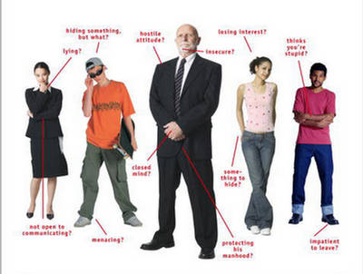

Slide 24
Gestures
The use of arms and hands to compliment voice and message
  Tips:
    Stay inside the box
    Don’t over-gesture
    The Most Effective Gestures Are Spontaneous

Slide 25
Face
Reflects the tone of the message
    For example:
      Motivational speech on Bolstering Creativity
      = energetic and happy
      Informational speech on AIDS in Africa
      = downcast and serious
  Your face should reflect the tone of the subject

Slide 26
Eye Contact
Important in…
  maintaining the flow of speech
  gauging the audience’s reaction
  holding the audience accountable
    Tips:
      Make your way around the room
      Maintain contact for approximately 1-2 sentences
  Make it Natural

Slide 27
Adapted from Toastmasters International
www.toastmasters.org/members

